Slide 1
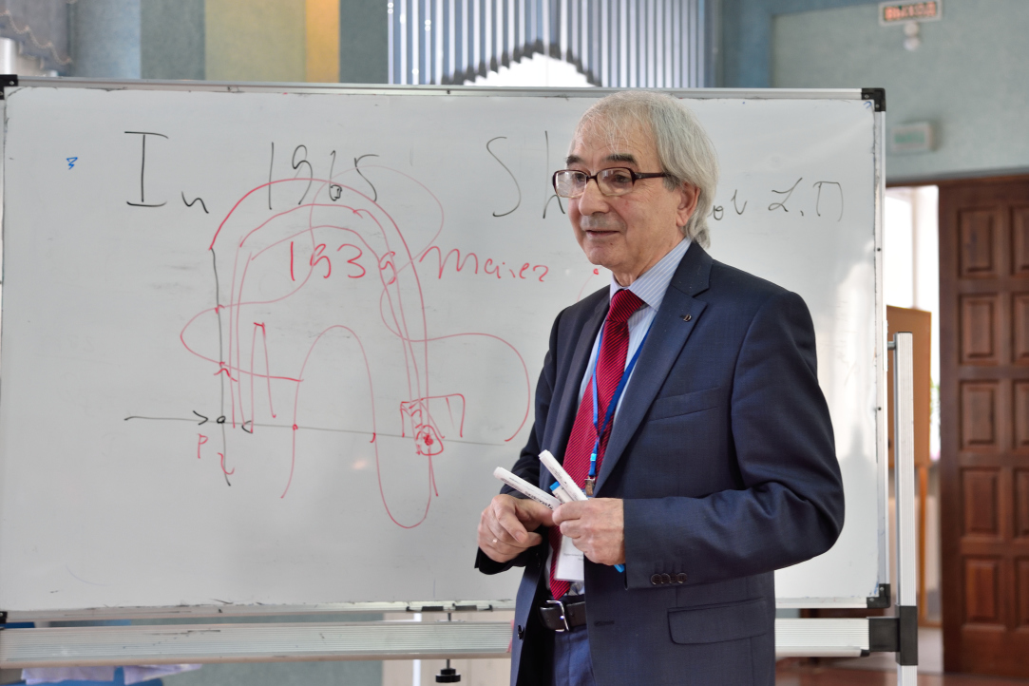
D.Sc., Professor Vyacheslav Grines,
Higher School of Economics, Russia

Slide 2
Scientific awards and Recognition
Honorary Worker of Higher Professional Education of Russia
Fields of interest
Dynamical Systems
Foliations on Manifolds
Professor
Grines‘ CV:

Slide 3
Professor Vyacheslav Grines
On interrelation of regular and chaotic dynamics with topology of an ambient manifold
19/08 17:00 Moscow time Lecture 1 20/08 17:00 Moscow time Lecture 2
21/08 17:00 Moscow time
Lecture 3

