Slide 1
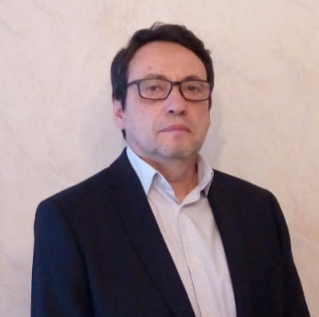
D.Sc., Professor Vitaly Volpert,
French National Centre for Scientific Research, France,
RUDN University, Russia

Slide 2
Scientific awards and Recognition
Prize of the Friends of the University of Lyon for the best DEA internship
Best Paper Award at the 15th Microgravity and Space Processing Symposium for the paper “Effective interfacial tension induced convection in miscible fluids”
Schelkin Prize of the Russian Academy of Sciences
Prize of the Competition for young researchers, Institute of Problems of Chemical Physics of RAS

Slide 3
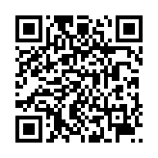
Fields of interest
General theory of elliptic equations in unbounded domains
Mathematical theory of reaction-diffusion waves with applications in chemical kinetics and combustion
Nonlocal reaction-diffusion equations and equations with delay
Vibrational thermal explosion
Capillary phenomena in miscible fluids
Mathematical theory of the origin and evolution of species
Mathematical theory and modeling of biomedical processes: atherosclerosis and other chronic inflammations, blood clotting and thrombosis, cancer
Professor
Volpert‘s CV:

Slide 4
Professor Vitaly Volpert
Reaction-diffusion equations in biology
and medicine
19/08 18:00 Moscow time Lecture 1 20/08 18:00 Moscow time Lecture 2
21/08 18:00 Moscow time
Lecture 3

