Slide 1
Education
Science
Collaboration
НАЗВАНИЕ ПРЕЗЕНТАЦИИ. НАБИРАЙТЕ ЗАГОЛОВОК.
Mathematical Institute

Slide 2
Education
Mathematical Institute
Pre-University Faculty.
Foreign students usually study the Russian language and the basic subjects necessary for the chosen profession at Pre-University Faculty. This year RUDN University launches a new project — “Digital Pre-University Faculty“.
Bashelor's degree: Programs “Mathematics" and "Applied Mathematics and Informatics“.
Master’s degree: Programs “Non-classical problems of analysis and differential equations, mathematical modelling and machine learning”, “Mathematical models in interdisciplinary research”.

Slide 3
Education
Mathematical Institute
Postgraduate and doctoral studies
01.01.01. Real, complex and functional analysis,
01.01.02. Differential equations, dynamical systems and optimal control problems,
01.02.01.Theoretical mechanics.
Dissertation Council D 212.203.27 on “Real, complex and functional analysis" and "Differential equations, dynamical systems and optimal control problems".
Mathematical Institute
Education

Slide 4
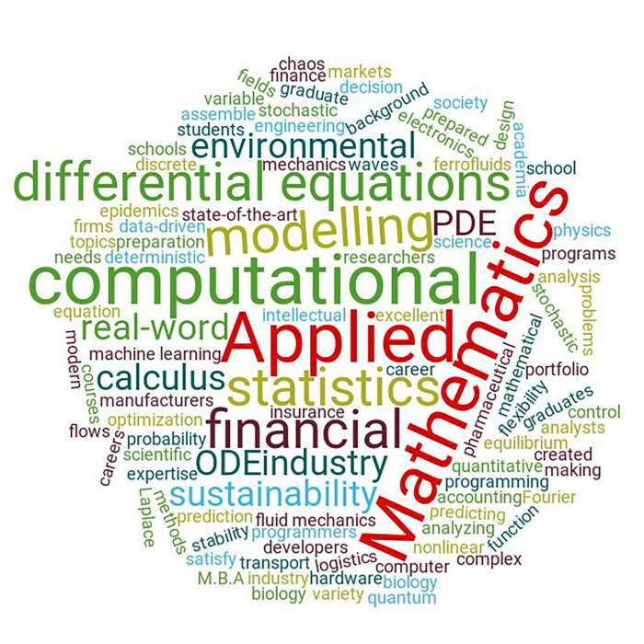
Science: fields of research
Mathematical Institute
Boundary-value problems for differential and functional differential equations
Nonlocal boundary-value problems
Nonlinear elliptic and parabolic functional differential equations
Kinetic equations
Operator theory and function spaces
Spectral theory of operators
Mathematical medicine
Mathematical modelling and numerical methods for mathematical physics
Interdisciplinary center for Mathematical modelling in Biomedicine (Prof. V.А. Volpert)
Scientific center of nonlinear problems of mathematical physics (Prof. А.Е. Shishkov)

Slide 5
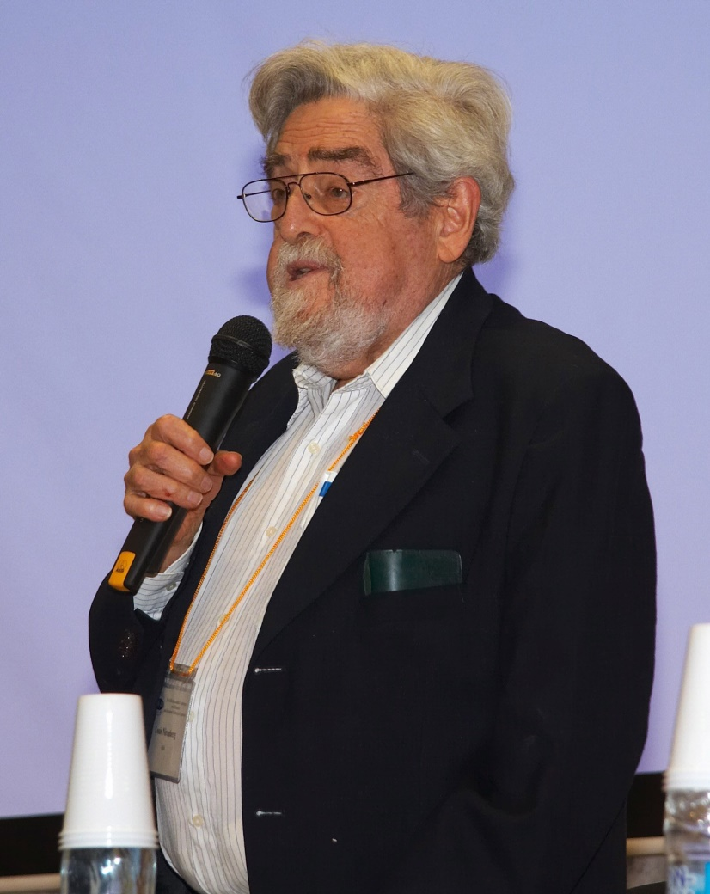
Science: scientific seminars and conferences
Mathematical Institute
Our conferences DFDE is devoted to classical topics of theory of differential equations and different kinds of nonlocal interactions: ordinary differential equations, partial differential equations, functional differential equations, dynamical systems, and applications.
DFDE-2021 is the ninth in the series of international conferences which take place every three years. Our conference DFDE-2002 and DFDE-2014 were acknowledged as satellites of International Congresses of Mathematicians.
L. Nirenberg. Laureate of Abel Prize, Steele Prize, Chern Medal. He repeatedly took part in our conferences DFDE.

Slide 6
Science: scientific seminars and conferences
Mathematical Institute
Scientific seminar on differential and functional differential equations (chair: Prof. A.Skubachevskii)
Scientific seminar on differential geometry (chair: Prof. A.Savin)
Prof. H.-O. Walter at our seminar.

Slide 7
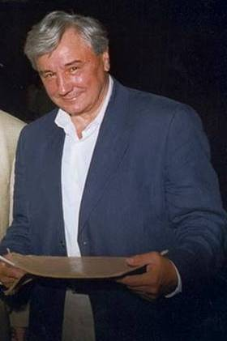
Science: scientific seminars and conferences
Mathematical Institute
Scientific seminar on mathematical modelling in biology and medicine (chair: Prof. V.Volpert)
Scientific Seminar on nonlinear Problems of Partial Differential Equations and Mathematical Physics (chair: Prof. A.Shishkov)
Academician S.P. Novikov. Laureate of Lenin Prize, Fields Medal, Lobachevsky Medal, Wolf Prize. He repeatedly took part in our conferences DFDE.

Slide 8
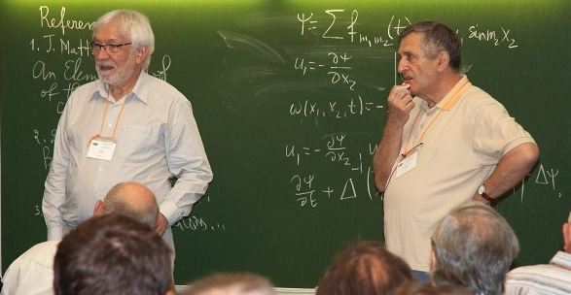
Science: scientific seminars and conferences
Mathematical Institute
Scientific seminar on functional analysis and its applications (chair: Prof. V.Burenkov)
Scientific seminar on spectral theory of operators (chair: Prof. M.Malamud)
Seminar on neural networks (chair: N.Anosova)
Postgraduate mathematical seminar (chair: Yu.Belyaeva)
W. Jaeger has won Blaise Pascal Medal for Mathematics, Bolzano Medal.
Ya.G. Sinai has won Nemmers Prize, Wolf Prize in Mathematics and the Abel Prize.
They repeatedly made presentations at our seminars and took part in our conferences DFDE.

Slide 9
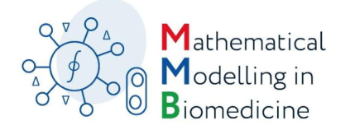
Science: scientific seminars and conferences
Mathematical Institute
Mathematical modelling in biomedicine
(September 30 – October 4, 2019)
Singular Problems, Blow-up, and Regimes with Peaking in Nonlinear PDEs (November 10-14, 2019)
We are glad
to invite you!
The 9th International Conference on Differential and Functional Differential Equations (August, 2021)

Slide 10
Collaboration
Mathematical Institute
Lomonosov Moscow State University
Steklov Mathematical Institute of RAS
Sobolev Institute of Mathematics of RAS
Keldysh Institute of Applied Mathematics of RAS
Marchuk Institute of Numerical Mathematics of RAS
Ishlinsky Institute for Problems of Mechanics of RAS
Federal Research Center "Computer Science and Control" of RAS

Slide 11
Collaboration
Mathematical Institute
Bar-Ilan University
Ecole Centrale de Casablanca
Friedrich Schiller University Jena
Justus Liebig University of Giessen
Leibniz University of Hannover
Ludwig Maximilian University of Munich
Padova University
Pompeu Fabra University
Ruprecht Karl University of Heidelberg
University of Lyon
Vanderbilt University

Slide 12
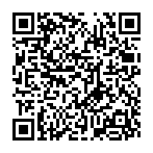
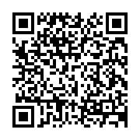
Mathematical Institute:
Contacts
Director Alexander Skubachevskii
Tel.: +7 (495) 955-07-10
E-mail: skubachevskii-al@rudn.ru
VK: https://vk.com/math_rudn
Address for correspondence: S.M. Nikol’skii Mathematical Institute, RUDN University,
6 Miklukho-Maklaya str., 117198 Moscow, Russia
Our site (in Russian)
Our site (in English)

