Slide 1
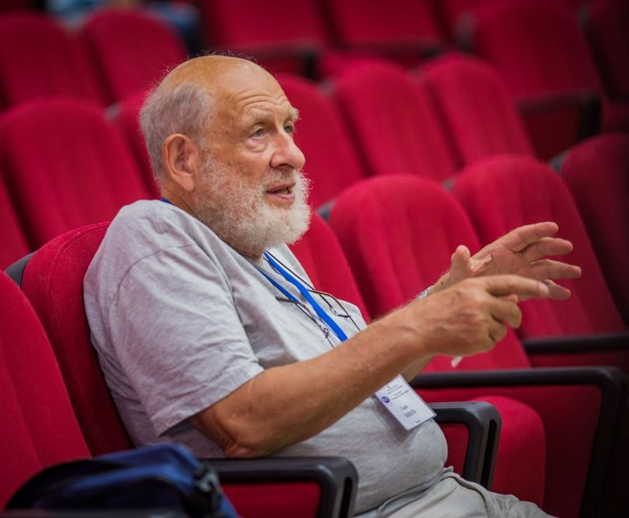
Professor Claude Bardos,
University Denis Diderot, France

Slide 2
Scientific awards and Recognition
Edmond BRUN Prize of the Académie of Sciences of France
Humbolt Prize (RFA, Kaiserslautern University)
Grand Prix Marcel Dassault de l'Académie des Sciences Paris
SIAM Fellow
Consultant at the Nat. Scientific Lab. Los Alamos
Consultant at INRIA
Consultant at Hutchinson and others

Slide 3
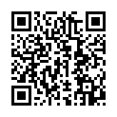
Fields of interest
Microlocal analysis and theorem of propagation to contribute to the solution of practical problems
Equations of fluid mechanics like Navier—Stokes or Euler equations
Kinetic equations
The microlocal theory and its applications
Professor
Bardos’ CV:

Slide 4
Professor Claude Bardos
Vlasov equation: from derivation to quasilinear approximation
19/08 16:00 Moscow time Lecture 1 20/08 16:00 Moscow time Lecture 2
21/08 16:00 Moscow time
Lecture 3

