Slide 1

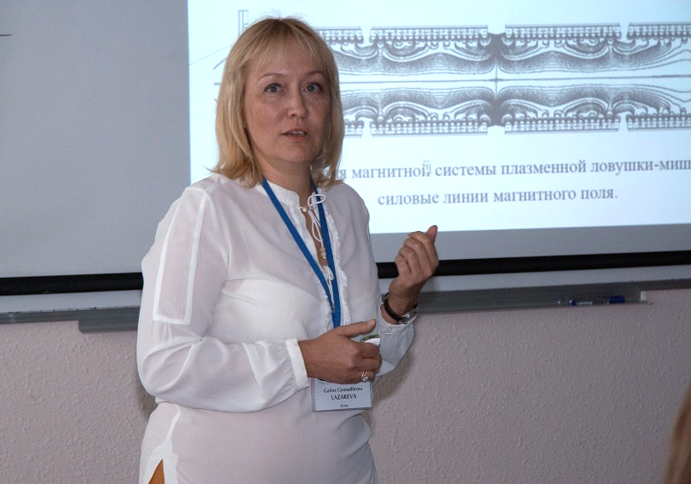


A.M., Professor Galina Lazareva,
RUDN University, Russia

Slide 2

Scientific awards
and Recognition
Corresponding Member of the Russian Academy of Sciences
Honorary academic title of professor of RAS
Member of expert Council of the Higher Attestation Committee on Ruling, Computing and Informatics at Ministry of education and science
Expert of the Russian Foundation for basic research

Slide 3

Fields of interest
Computational mathematics
Parallel computing algorithms
Mathematical modeling of tungsten erosion by pulsed action of a powerful electron beam
Simulation of low-temperature multicomponent plasma in a target trap
Simulation of mantle plumes
Simulation of dynamics of astrophysical objects
Mathematical modeling for two-phase cluster in liquids
Professor
Lazareva‘s CV:

Slide 4
Professor Galina Lazareva
Mathematical modeling of compressible fluids
20/08 12:00 Moscow time
Lecture 1. Introduction to compressible flow
21/08 11:00 Moscow time
Lecture 2. Mathematical modeling of compressible fluids
21/08 12:00 Moscow time
Lecture 3. Applications: the hydrodynamics of interacting galaxies

